Slide 1
Government Accounts and their Vulnerabilities
Justin Whitlock

Slide 2
Readings
Justin Littman. Suspended U.S. government Twitter accounts. Social Feed Manager Blog. GWU Libraries, 04 November 2017. https://gwu-libraries.github.io/sfm-ui/posts/2017-11-04-digital-registry
Justin Littman. Vulnerabilities in the U.S. Digital Registry, Twitter, and the Internet Archive. Social Feed Manager Blog. GWU Libraries , 06 November 2017. https://gwu-libraries.github.io/sfm-ui/posts/2017-11-06-vulnerabilities
Notes:
Social feed manager: software tool for building data sets from social media.

Slide 3
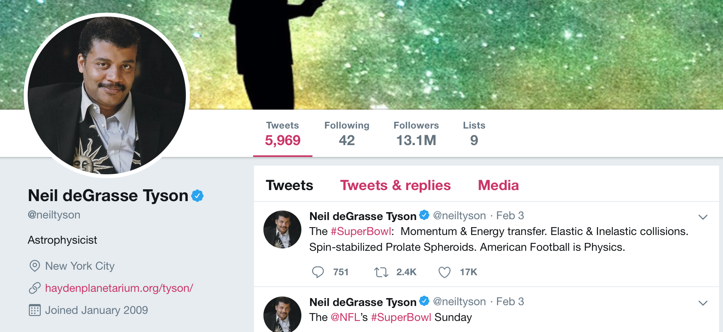

Background: Twitter
Verified Accounts
Twitter determines the account to be of public interest
Suspended Accounts
Spam or fake
Compromised or hacked
Abusive or threatening behavior
Protected/Private Accounts
Only visible to followers
Deleted Accounts
Deleted by the user

Slide 4
Background
End of Term Project (EOT)
2008-present
Archive the web presence of the U.S. Federal government at the end of a presidential term.
Collected the tweets of 3000 government accounts.
These can include:
main agency accounts
departmental accounts
project accounts, etc.
Maintain a list of government agency accounts.
source - U.S. Digital Registry: Official list of trusted government social media accounts.
Notes:
presidential libraries act 1955
Presidential Records Act 1978

Slide 5
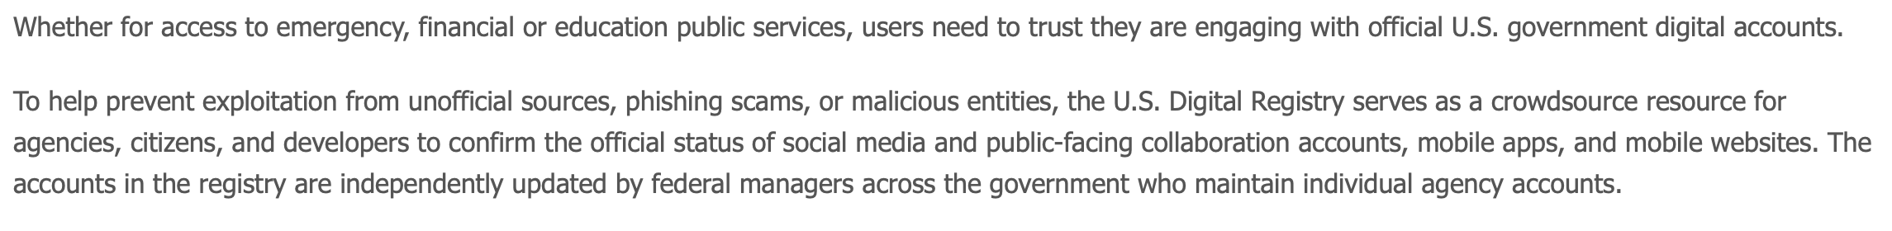
U.S. Digital Registry
“Users need to trust they are engaging with official U.S government digital accounts”
“The accounts… are independently updated by federal managers…”

Slide 6
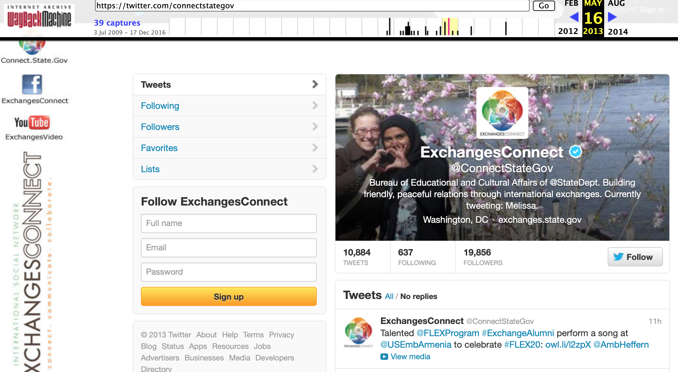
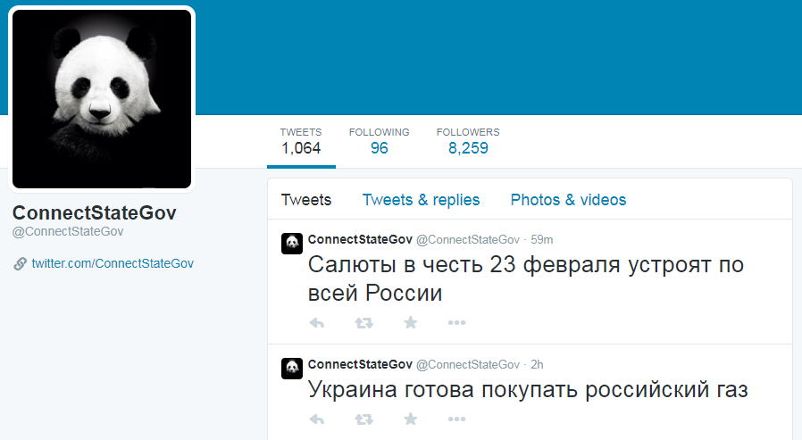
Something Weird
Suspended U.S. Government accounts?
29 accounts that have been removed by twitter.
Still listed as official accounts in the U.S. Digital Registry.
Some suspended accounts showed signs of being recycled before suspension.
Notes:
Unknown why twitter suspended them.

Slide 7
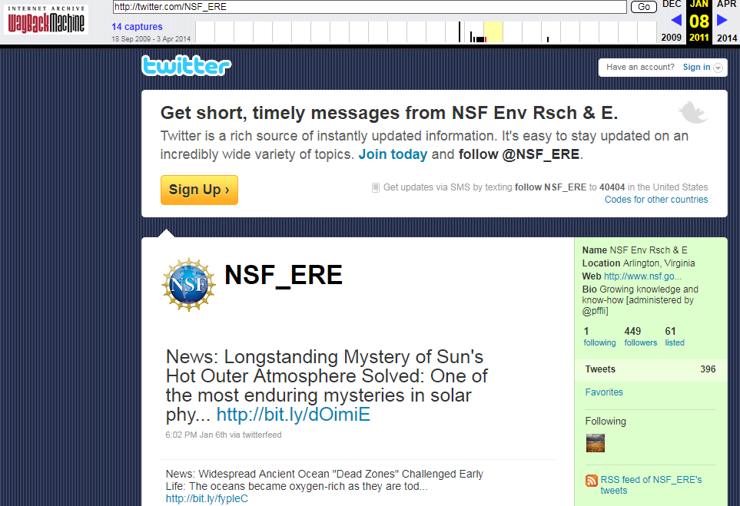
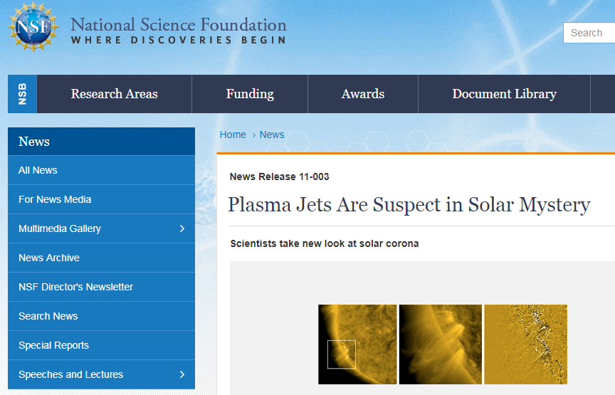
Reason for suspension unclear: NSF_ERE
The link is still good
takes you to a live article from 2011 on the NSF website
3 April 2014, nothing there

Slide 8
Timemap NSF_ERE: not found in other archives
Z:\>curl https://memgator.cs.odu.edu/timemap/link/http://twitter.com/NSF_ERE
<http://twitter.com/NSF_ERE>; rel="original",
<https://memgator.cs.odu.edu/timemap/link/http://twitter.com/NSF_ERE>; rel="self"; type="application/link-format",
<http://wayback.archive-it.org/all/20090918235036/http://twitter.com/NSF_ERE>; rel="first memento"; datetime="Fri, 18 Sep 2009 23:50:36 GMT",
<http://web.archive.org/web/20090918235036/http://twitter.com/NSF_ERE>; rel="memento"; datetime="Fri, 18 Sep 2009 23:50:36 GMT",
<http://web.archive.org/web/20090918235036/http://twitter.com/NSF_ERE>; rel="memento"; datetime="Fri, 18 Sep 2009 23:50:36 GMT",
<http://wayback.archive-it.org/all/20090919010723/https://twitter.com/NSF_ERE>;rel="memento"; datetime="Sat, 19 Sep 2009 01:07:23 GMT",
<http://web.archive.org/web/20090919010723/https://twitter.com/NSF_ERE>; rel="memento"; datetime="Sat, 19 Sep 2009 01:07:23 GMT",
<http://web.archive.org/web/20090919010723/https://twitter.com/NSF_ERE>; rel="memento"; datetime="Sat, 19 Sep 2009 01:07:23 GMT",
<http://wayback.archive-it.org/all/20100407220903/http://twitter.com/NSF_ERE>; rel="memento"; datetime="Wed, 07 Apr 2010 22:09:03 GMT",
<http://web.archive.org/web/20100407220903/http://twitter.com/NSF_ERE>; rel="memento"; datetime="Wed, 07 Apr 2010 22:09:03 GMT",
<http://web.archive.org/web/20100407220903/http://twitter.com/NSF_ERE>; rel="memento"; datetime="Wed, 07 Apr 2010 22:09:03 GMT",
<http://wayback.archive-it.org/all/20100606125859/http://twitter.com/NSF_ERE>; rel="memento"; datetime="Sun, 06 Jun 2010 12:58:59 GMT",
<http://web.archive.org/web/20100606125859/http://twitter.com/NSF_ERE>; rel="memento"; datetime="Sun, 06 Jun 2010 12:58:59 GMT",
<http://wayback.archive-it.org/all/20100808074234/http://twitter.com/NSF_ERE>; rel="memento"; datetime="Sun, 08 Aug 2010 07:42:34 GMT",
<http://web.archive.org/web/20100808074234/http://twitter.com/NSF_ERE>; rel="memento"; datetime="Sun, 08 Aug 2010 07:42:34 GMT",
<http://wayback.archive-it.org/all/20100908193645/http://twitter.com/NSF_ERE>; rel="memento"; datetime="Wed, 08 Sep 2010 19:36:45 GMT",
<http://web.archive.org/web/20100908193645/http://twitter.com/NSF_ERE>; rel="memento"; datetime="Wed, 08 Sep 2010 19:36:45 GMT",
<http://wayback.archive-it.org/all/20101008215008/http://twitter.com/NSF_ERE>; rel="memento"; datetime="Fri, 08 Oct 2010 21:50:08 GMT",
<http://web.archive.org/web/20101008215008/http://twitter.com/NSF_ERE>; rel="memento"; datetime="Fri, 08 Oct 2010 21:50:08 GMT",
<http://wayback.archive-it.org/all/20101111102804/http://twitter.com/NSF_ERE>; rel="memento"; datetime="Thu, 11 Nov 2010 10:28:04 GMT",
<http://web.archive.org/web/20101111102804/http://twitter.com/NSF_ERE>; rel="memento"; datetime="Thu, 11 Nov 2010 10:28:04 GMT",
<http://wayback.archive-it.org/all/20101206082809/http://twitter.com/NSF_ERE>; rel="memento"; datetime="Mon, 06 Dec 2010 08:28:09 GMT",
<http://web.archive.org/web/20101206082809/http://twitter.com/NSF_ERE>; rel="memento"; datetime="Mon, 06 Dec 2010 08:28:09 GMT",
<http://wayback.archive-it.org/all/20110108131145/http://twitter.com/NSF_ERE>; rel="memento"; datetime="Sat, 08 Jan 2011 13:11:45 GMT",
<http://web.archive.org/web/20110108131145/http://twitter.com/NSF_ERE>; rel="memento"; datetime="Sat, 08 Jan 2011 13:11:45 GMT",
<http://web.archive.org/web/20140403035124/http://twitter.com/NSF_ERE>; rel="last memento"; datetime="Thu, 03 Apr 2014 03:51:24 GMT",
. . . deletia . . .

Slide 9
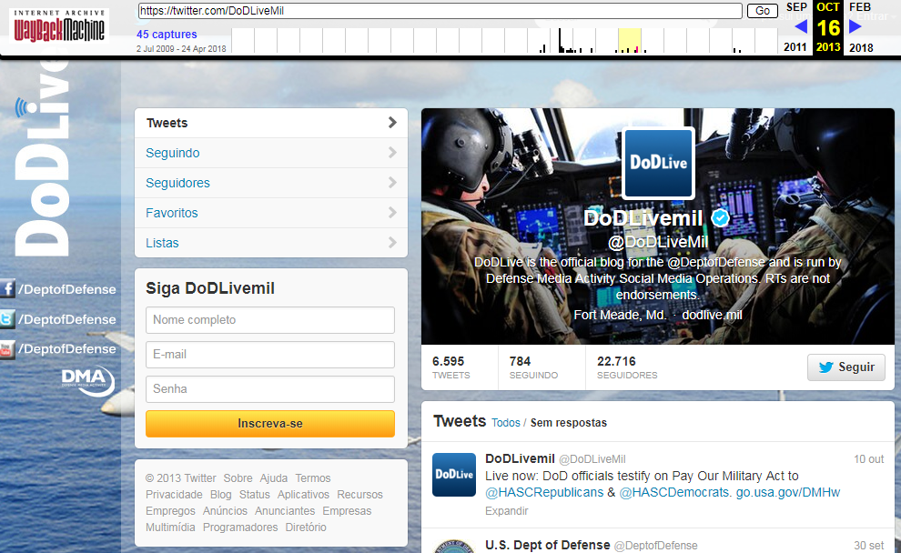
Reason for suspension unclear: DoDLiveMil

Slide 10
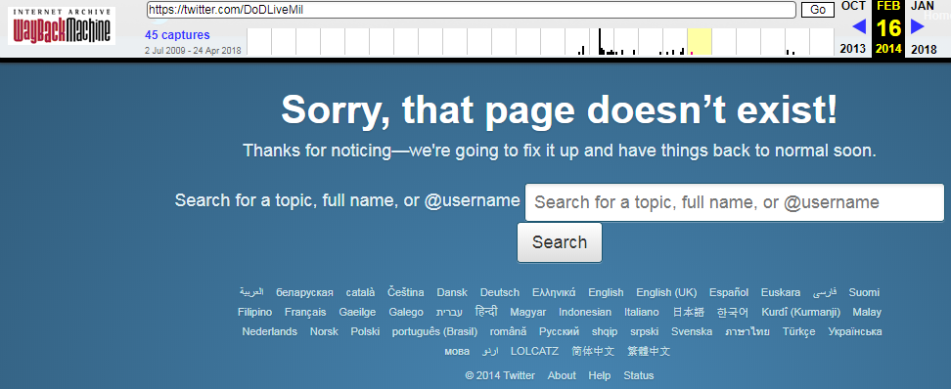
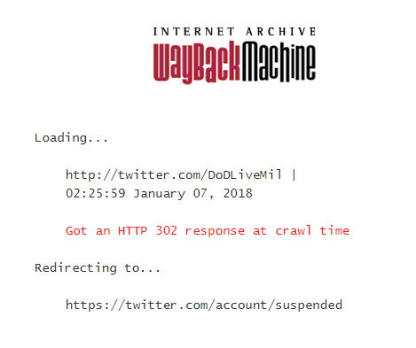
Reason for suspension unclear: DoDLiveMil
Feb 2016, account was deleted?
Jan 2018, account was suspended
Why suspend a deleted account?

Slide 11
Time map DoDLiveMil: Not found in other archives
Z:\>curl https://memgator.cs.odu.edu/timemap/link/http://twitter.com/NSF_ERE
<http://twitter.com/NSF_ERE>; rel="original",
<https://memgator.cs.odu.edu/timemap/link/http://twitter.com/NSF_ERE>; rel="self";type="application/link-format",
<http://wayback.archive-it.org/all/20090918235036/http://twitter.com/NSF_ERE>; rel="first memento"; datetime="Fri, 18 Sep 2009 23:50:36 GMT",
<http://web.archive.org/web/20090918235036/http://twitter.com/NSF_ERE>; rel="memento"; datetime="Fri, 18 Sep 2009 23:50:36 GMT",
<http://web.archive.org/web/20090918235036/http://twitter.com/NSF_ERE>; rel="memento"; datetime="Fri, 18 Sep 2009 23:50:36 GMT",
<http://wayback.archive-it.org/all/20090919010723/https://twitter.com/NSF_ERE>;rel="memento"; datetime="Sat, 19 Sep 2009 01:07:23 GMT",
<http://web.archive.org/web/20090919010723/https://twitter.com/NSF_ERE>; rel="memento"; datetime="Sat, 19 Sep 2009 01:07:23 GMT",
<http://web.archive.org/web/20090919010723/https://twitter.com/NSF_ERE>; rel="memento"; datetime="Sat, 19 Sep 2009 01:07:23 GMT",
<http://wayback.archive-it.org/all/20100407220903/http://twitter.com/NSF_ERE>; rel="memento"; datetime="Wed, 07 Apr 2010 22:09:03 GMT",
<http://web.archive.org/web/20100407220903/http://twitter.com/NSF_ERE>; rel="memento"; datetime="Wed, 07 Apr 2010 22:09:03 GMT",
<http://web.archive.org/web/20100407220903/http://twitter.com/NSF_ERE>; rel="memento"; datetime="Wed, 07 Apr 2010 22:09:03 GMT",
<http://wayback.archive-it.org/all/20100606125859/http://twitter.com/NSF_ERE>; rel="memento"; datetime="Sun, 06 Jun 2010 12:58:59 GMT",
<http://web.archive.org/web/20100606125859/http://twitter.com/NSF_ERE>; rel="memento"; datetime="Sun, 06 Jun 2010 12:58:59 GMT",
<http://wayback.archive-it.org/all/20100808074234/http://twitter.com/NSF_ERE>; rel="memento"; datetime="Sun, 08 Aug 2010 07:42:34 GMT",
<http://web.archive.org/web/20100808074234/http://twitter.com/NSF_ERE>; rel="memento"; datetime="Sun, 08 Aug 2010 07:42:34 GMT",
<http://wayback.archive-it.org/all/20100908193645/http://twitter.com/NSF_ERE>; rel="memento"; datetime="Wed, 08 Sep 2010 19:36:45 GMT",
<http://web.archive.org/web/20100908193645/http://twitter.com/NSF_ERE>; rel="memento"; datetime="Wed, 08 Sep 2010 19:36:45 GMT",
<http://wayback.archive-it.org/all/20101008215008/http://twitter.com/NSF_ERE>; rel="memento"; datetime="Fri, 08 Oct 2010 21:50:08 GMT",
<http://web.archive.org/web/20101008215008/http://twitter.com/NSF_ERE>; rel="memento"; datetime="Fri, 08 Oct 2010 21:50:08 GMT",
<http://wayback.archive-it.org/all/20101111102804/http://twitter.com/NSF_ERE>; rel="memento"; datetime="Thu, 11 Nov 2010 10:28:04 GMT",
<http://web.archive.org/web/20101111102804/http://twitter.com/NSF_ERE>; rel="memento"; datetime="Thu, 11 Nov 2010 10:28:04 GMT",
<http://wayback.archive-it.org/all/20101206082809/http://twitter.com/NSF_ERE>; rel="memento"; datetime="Mon, 06 Dec 2010 08:28:09 GMT",
<http://web.archive.org/web/20101206082809/http://twitter.com/NSF_ERE>; rel="memento"; datetime="Mon, 06 Dec 2010 08:28:09 GMT",
<http://wayback.archive-it.org/all/20110108131145/http://twitter.com/NSF_ERE>; rel="memento"; datetime="Sat, 08 Jan 2011 13:11:45 GMT",
<http://web.archive.org/web/20110108131145/http://twitter.com/NSF_ERE>; rel="memento"; datetime="Sat, 08 Jan 2011 13:11:45 GMT",
<http://web.archive.org/web/20140403035124/http://twitter.com/NSF_ERE>; rel="last memento"; datetime="Thu, 03 Apr 2014 03:51:24 GMT",
. . . deletia . . .

Slide 12
Reasons for suspension?
Mistake?
Accidentally categorized as spam?
NSF_ERE was not authenticated.
If it’s still listed in the digital registry, how would you know if it had been taken over?
DoDLiveMil was authenticated
If someone recycled the handle, you should easily be able to tell the difference
Twitter authentication isn’t perfect
Fake account claiming to be Rupert Murdock’s wife.
https://web.archive.org/web/20190507183924/https://www.pcmag.com/news/292270/verified-twitter-account-for-rupert-murdochs-wife-is-fake

Slide 13
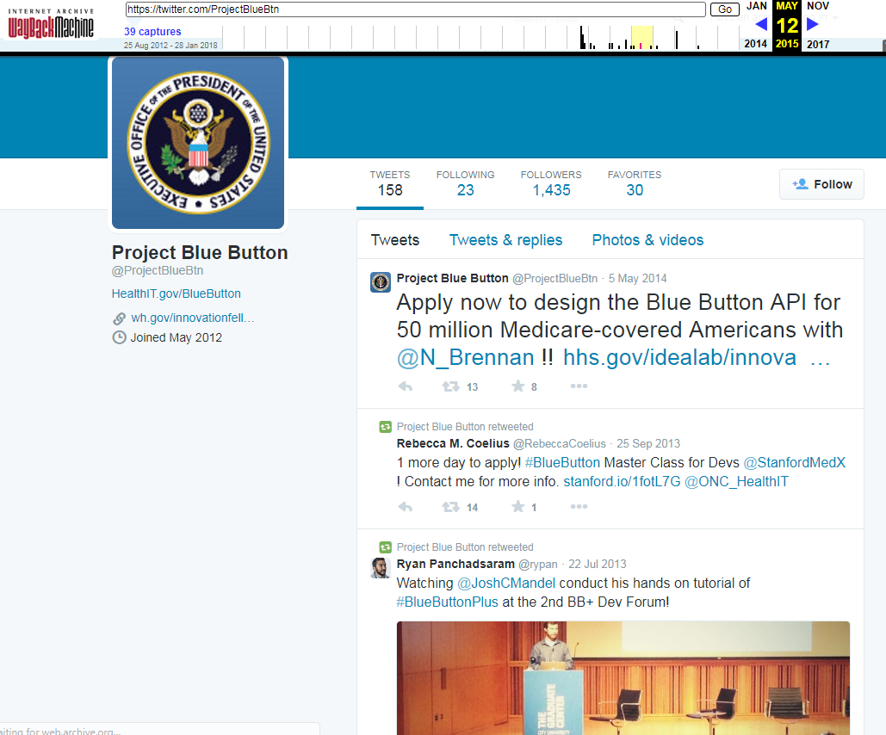
Accounts taken over
12 May 2015. Last capture before account was deleted.
Last tweet was 5 May 2014
Notes:
Sees them as the same because the address is the same

Slide 14
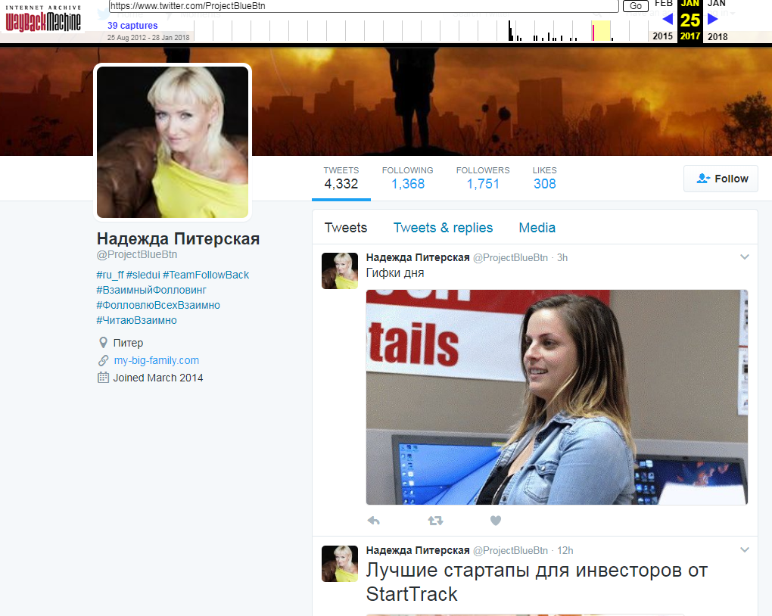
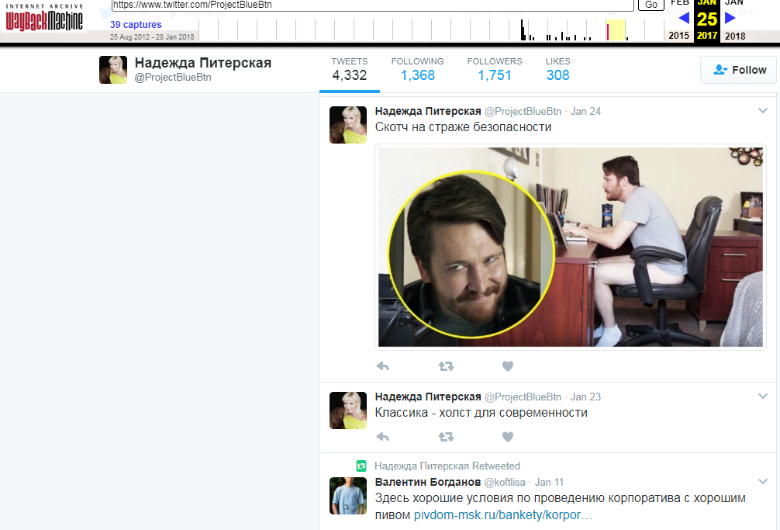
Account taken over
Same handle before it was suspended Jan 2017.
Probably an individual posting random stuff
Notes:
something about scotch guard?
Investors for startups on StartTrack

Slide 15
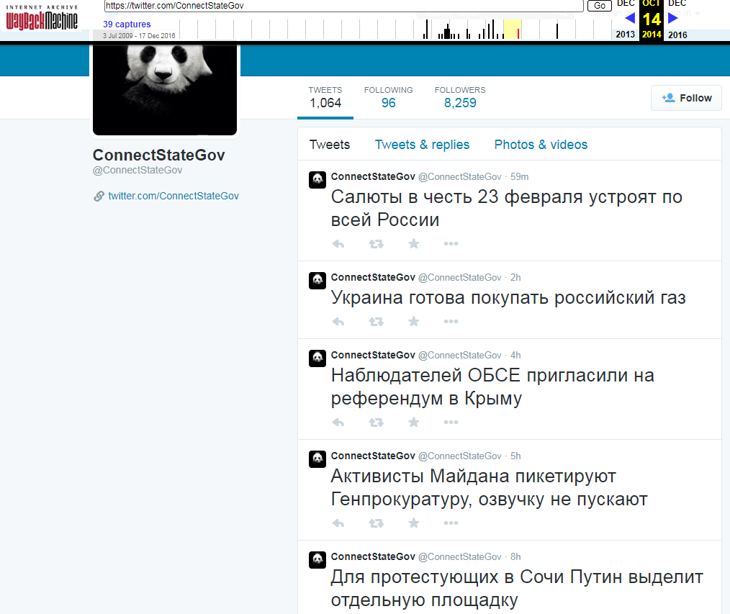
Back to the panda
“All of Russia salutes February 23”
“Ukraine is ready to buy Russian gas”
“OSCE observers invited to a referendum in Crimea”
“Activists of the Maidan picket the Prosecutor General's Office, voice acting is not allowed”
These tweets were all being posted just after Russia’s annexation of Crimea in February, 2014.
Pretty active: 5-10 tweets a day
Notes:
14 oct, it wasn’t until 30 october that they came to an agreement about the russian gas payments

Slide 16
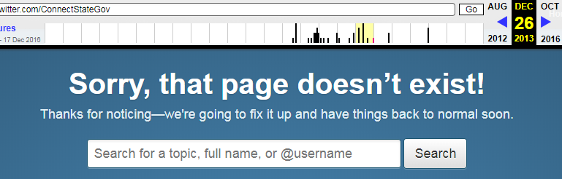
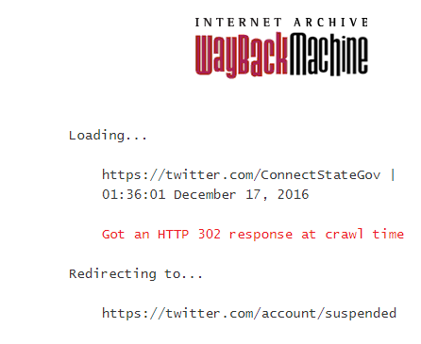
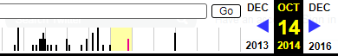
Back to the panda
26 Dec13: Deleted 14 Oct 14: Taken Over 17 Dec 16: Suspended
Notes:
Throughout the 4 years after the account was deleted, ConnectStateGov was listed as an official U.S. account

Slide 17
Bad Actors
Purpose of the U.S. Digital Register
Deter fake accounts and disinformation by verifying U.S. social media accounts
29 suspended accounts.
100 deleted accounts.
How easy would it be to pose as an official account and be authenticated by the registry?
Notes:
How easy would it be to pose as a government agency and spread false information?
If the U.S. Digital Registry says its an official account, would you look any further?

Slide 18
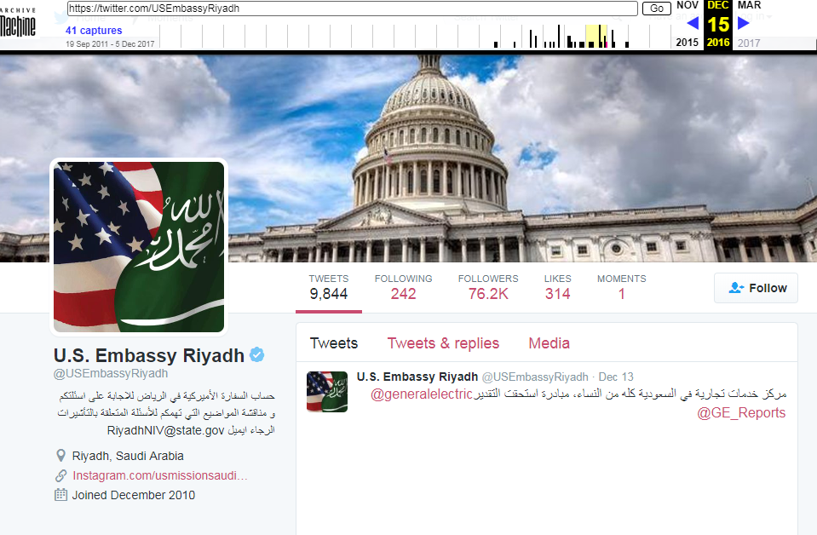
Posing as the government
15 Dec 16
Notes:
Last capture of the official page 15 Dec 16

Slide 19
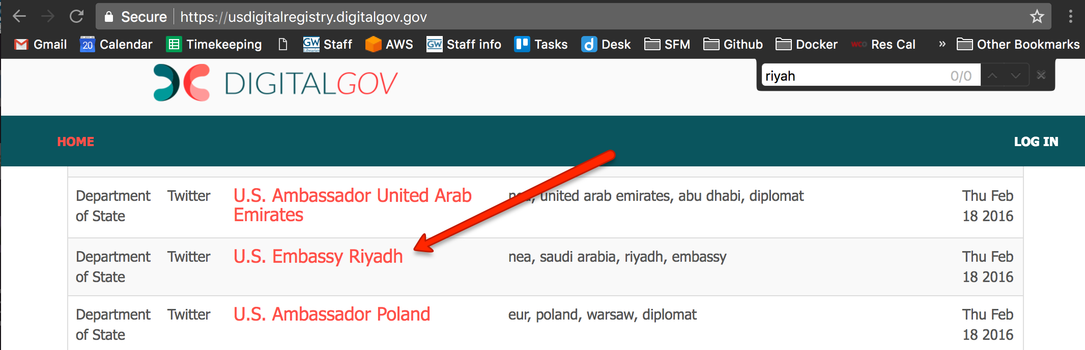
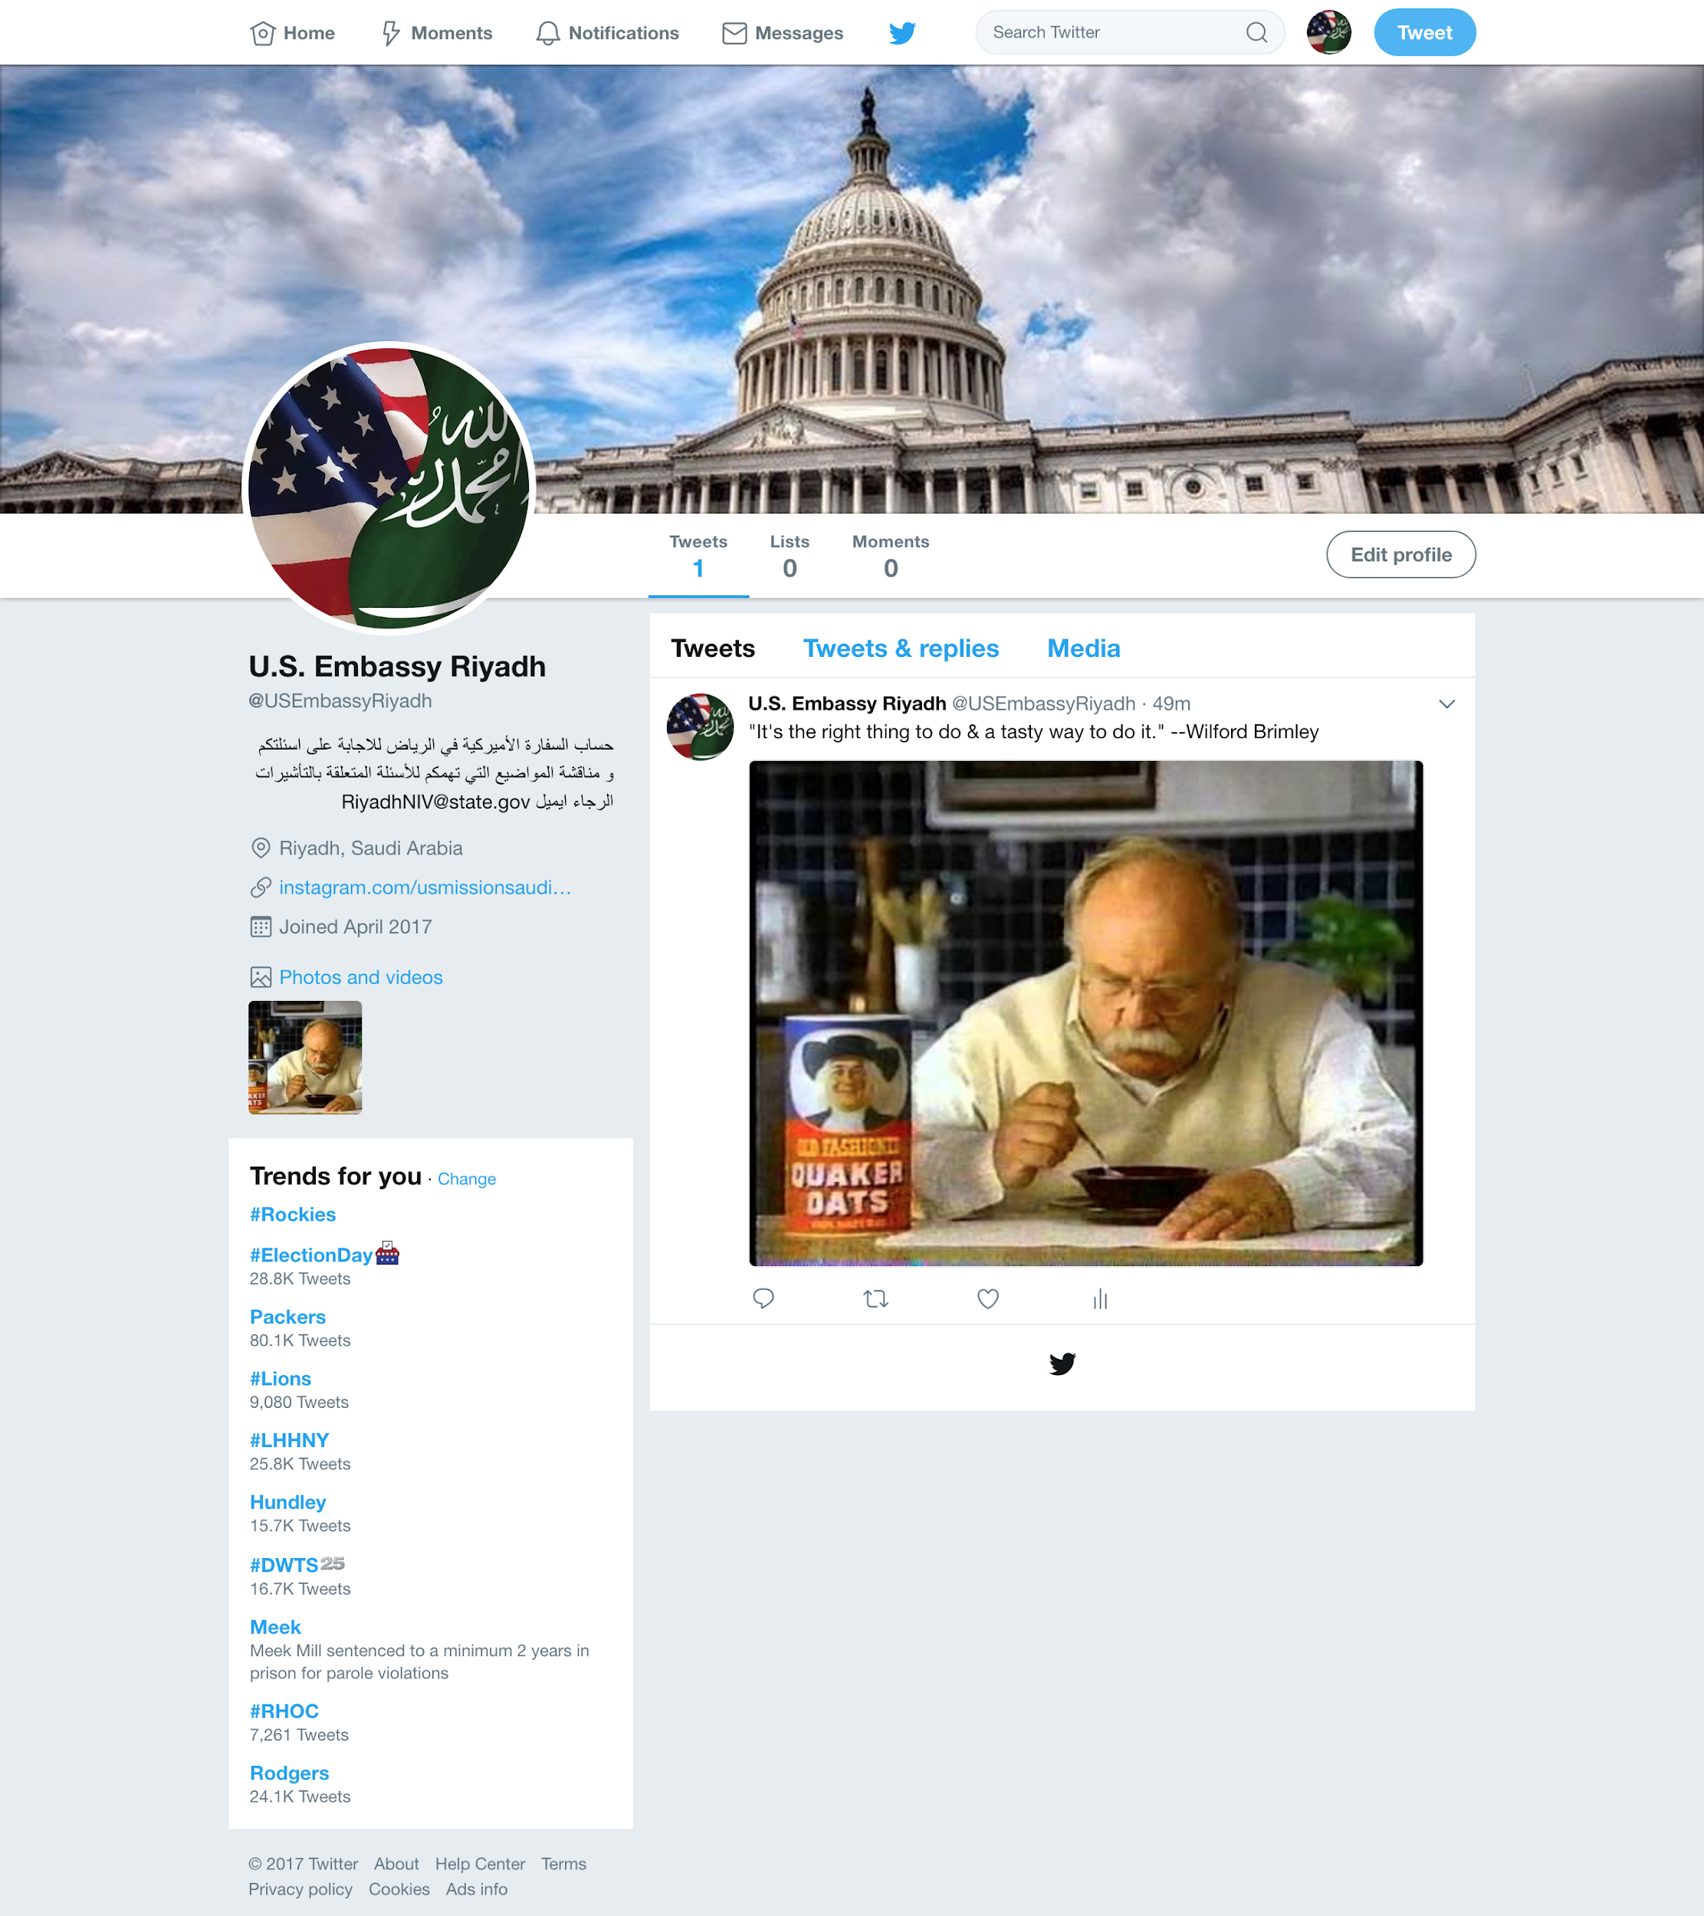
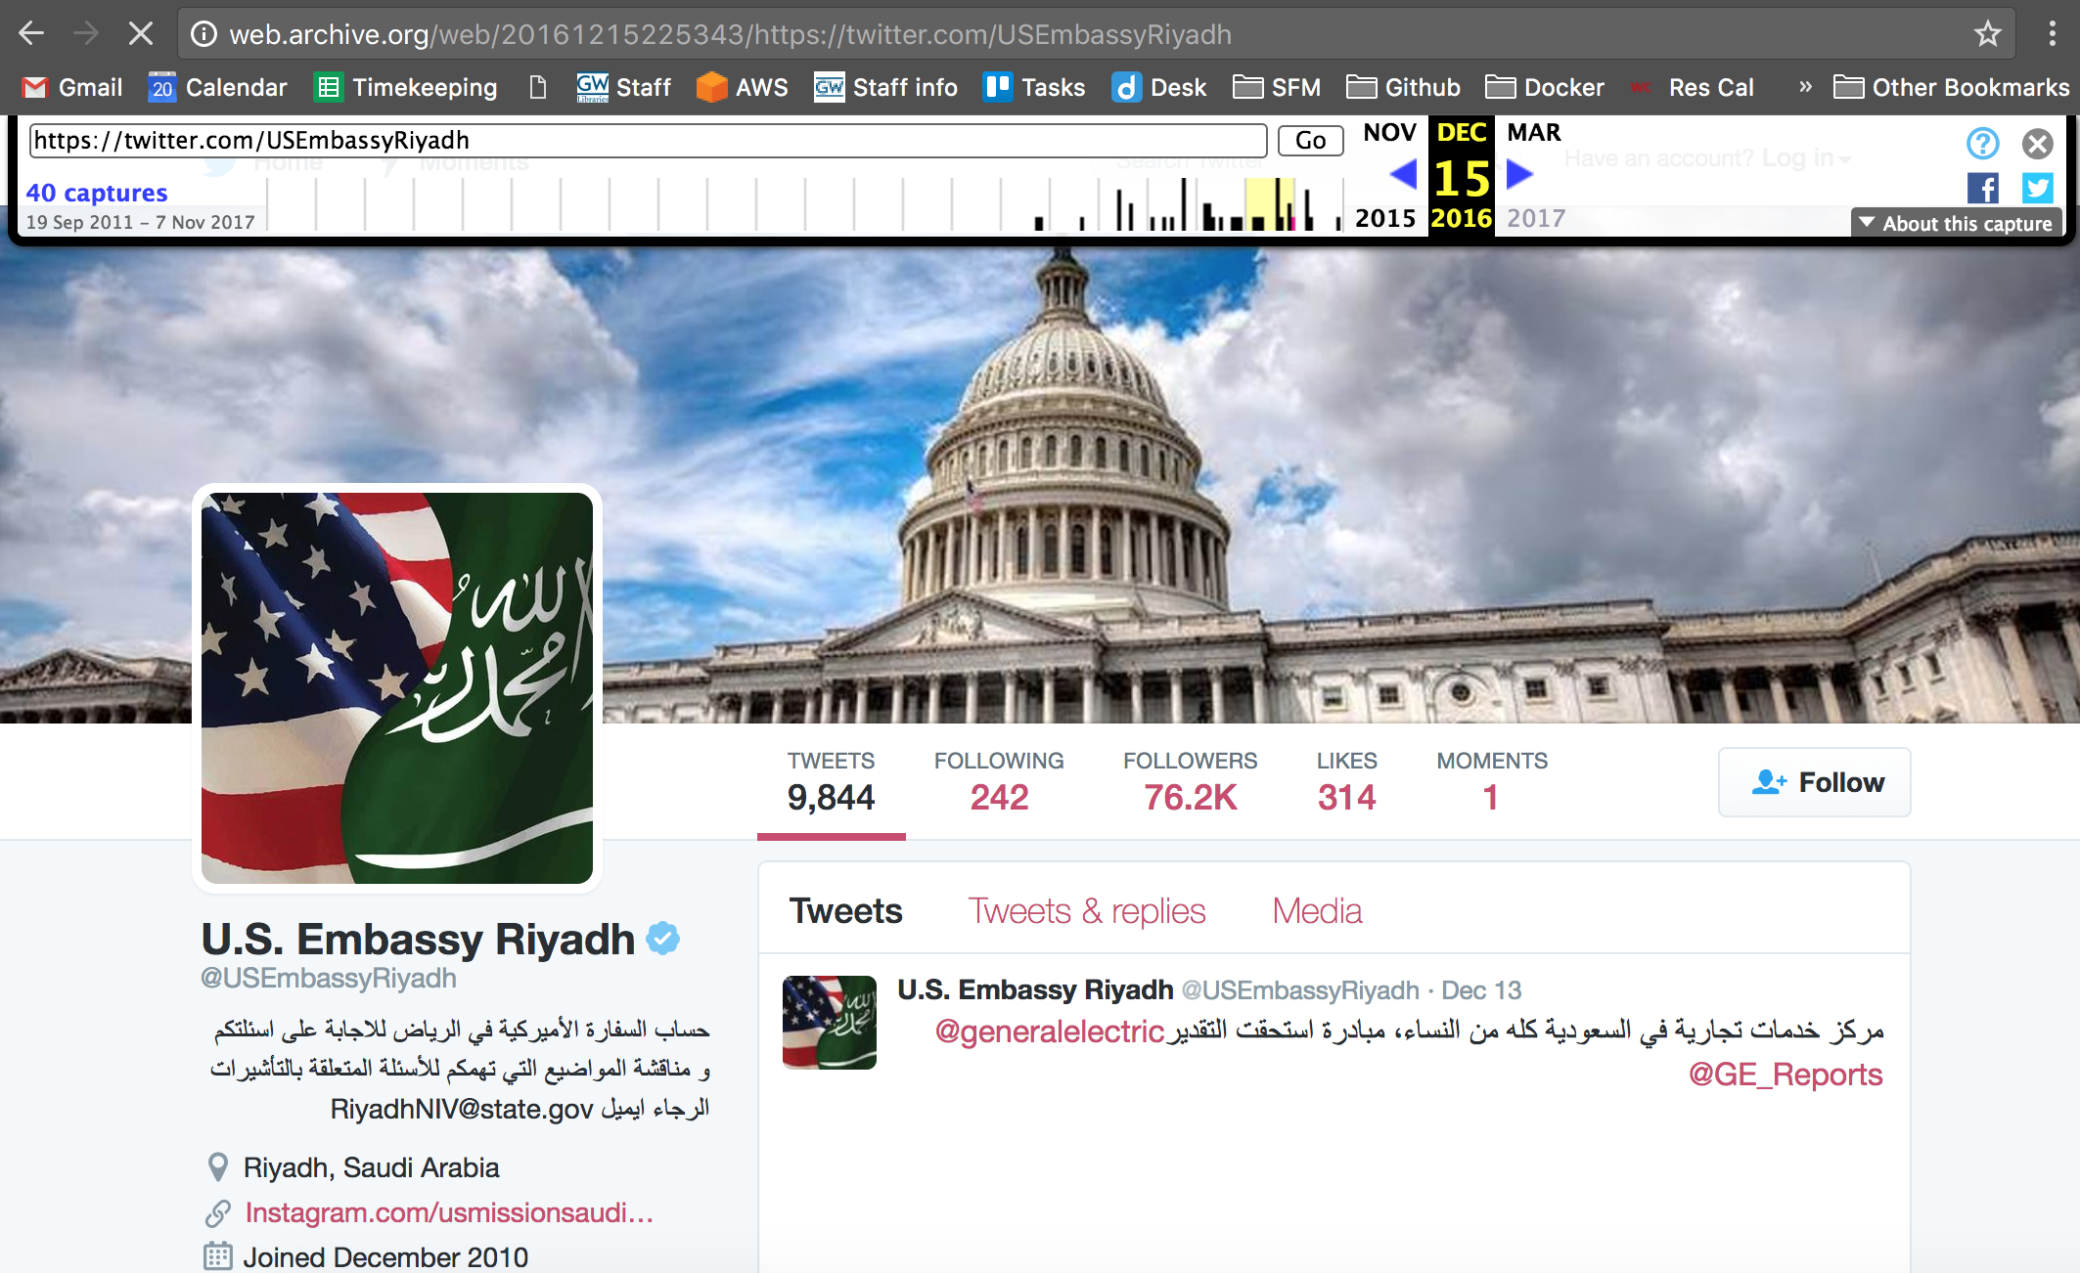
Posing as the government
FAKE
REAL
Notes:
Selected USEmbassyRiyadh, a deleted account
Registered the twitter handle
Used the internet archive to recreate the original account page
Posted a bunch of nonsense about wilford Brimley
2 main differences between the pages.
One is verified
One has a lot more tweets

Slide 20
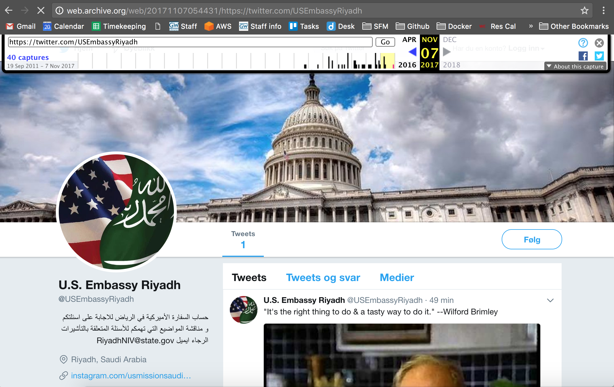
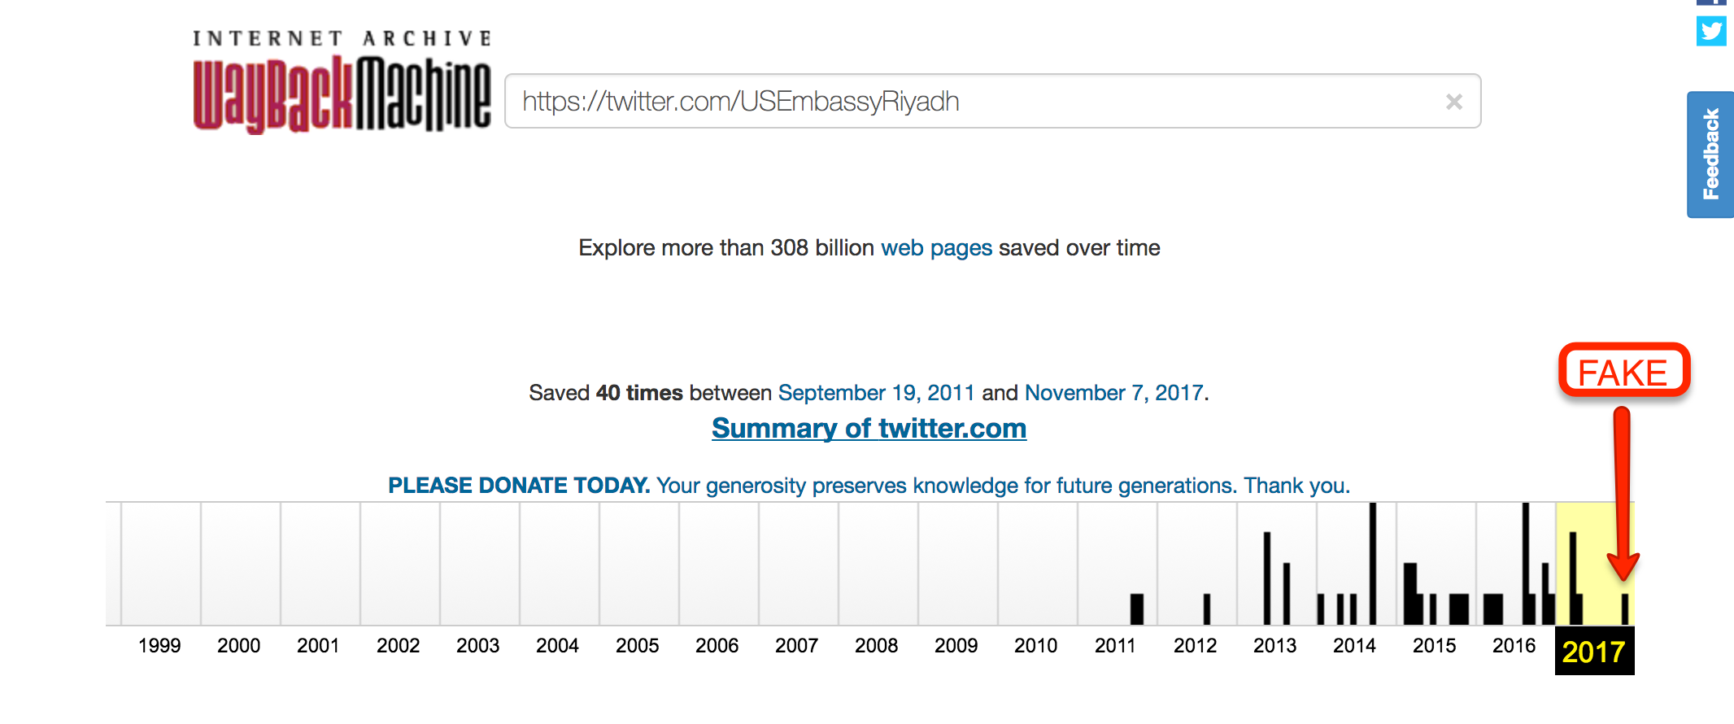
Altering History
Pushing into the Internet Archive
Page is the same, appended to the official history.
7 Nov 17
Notes:
Pushed the new page and tweet to the archive
The archive can’t tell the difference between the real page and the fake page
20 years from now, a person would have to look closely to tell the difference

Slide 21
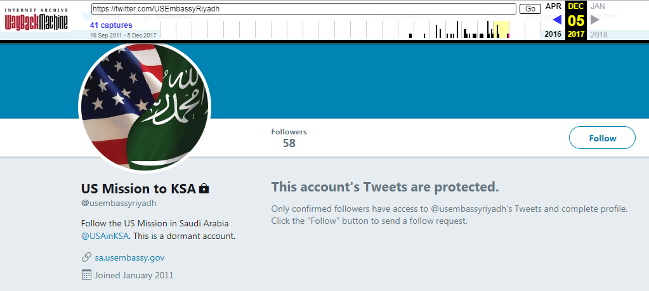
Oops
A month after the blog post, DoS reclaims the handle

Slide 22
Takeaway
U.S. Digital Registry needs to do more to maintain the integrity of the information they hold.
Regularly update account status
U.S. government accounts should all be verified.
Twitter
Organizational or Governmental accounts should not be recycled.
Internet Archive
Twitters API gives a lot information about accounts, could the Internet Archive use that to determine when an account changes hands?

Slide 23
Government adjusting to Technology
Hillary and her emails?
Email has been used extensively in the government since 1984.
Top government official technologically handicapped.
Twitter has been around since 2006
Not surprising that the government doesn’t have a handle on it.
Jimmy Daly. The History of Email in the Federal Government. FEDTECH Magazine. 15 July 2013. https://fedtechmagazine.com/article/2013/07/brief-history-email-federal-government
Twitter. Wikipedia. https://en.wikipedia.org/wiki/Twitter
Notes:
After email is introduction in the 1971s, quickly became 75% of traffic on ARPANET(1973)
Was introduced on .GOV and .MIL domains
when asked why she used a personal server and a blackberry instead of a secure desktop and server,
she said she was unfamiliar with the desktop, and
was under the impression previous secretaries of state had personal servers.

Slide 24
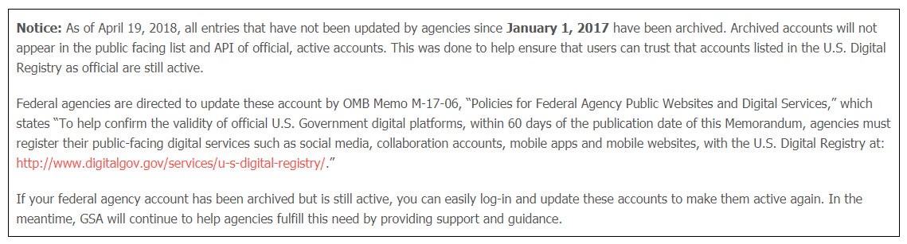
Government adjusting to Technology
In other news
Blog posts were from November 2017
This is a notice from the U.S. Digital Registries main page.

